Slide 1


Deep Optimizations of CNNs and Efficient Deployment on IoT Devices
Bharath Sudharsan and Pankesh Patel

Slide 2
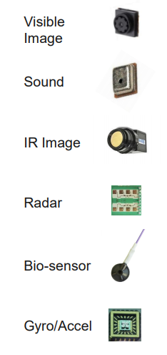
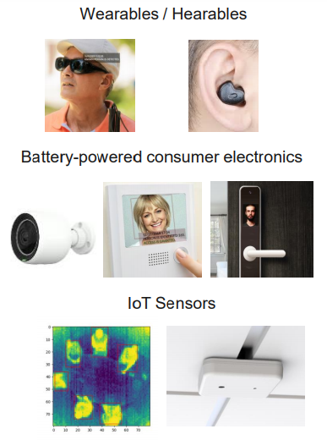
Neural Networks on IoT Devices
TinyML is ultra-low-power machine learning. Basically running NNs on MCUs. We categorize TinyML app landscape into
Audio-based always-on ML inference for context recognition, spot keywords/wake-words/control-words
Industry telemetry data-based use cases where models deployed on MCUs monitor IMUs, motor bearing vibrations, or other sensors to detect anomalies and predict equipment faults
Image data-based use cases such as object counting, text recognition, visual wake words
Physiological/behavior data-based use cases such as activity recognition using IMU or EMG data
Notes:
https://cms.tinyml.org/wp-content/uploads/summit2021/tinyMLSummit2021d3_Partner3_Carlson.pdf

Slide 3

Neural Networks on IoT Devices
Who are practicing TinyML: Executing NNs on their MCU-based products
Notes:
https://scholar.harvard.edu/files/vijay-janapa-reddi/files/tinymlsummit2020-4-4-janapareddi_01.pdf

Slide 4
Challenges in Prevailing Approaches
Existing Programming Frameworks
Compression levels, speedups produced by generic optimization toolkits in ML frameworks (e.g., PyTorch, Tensorflow) are not sufficient since they target are targeted for smartphones and better-resourced IoT hardware such as Raspberry Pis, Jetson Nano
The early-stage TF Lite for Microcontrollers core runtime can fit in 16 KB on an Arm Cortex M3 and run basic NNs on MCUs without needing operating system support or dynamic memory allocation
Still, to highly reduce the NN size before deploying and executing on MCUs using TF Micro, there is a need to optimize high memory, computation demanding models in multiple aspects to produce small size, low latency, low-power consuming models that can comfortably fit and execute on resource-constrained MCU-based IoT hardware

Slide 5
Challenges in Prevailing Approaches
Performance Metrics Trade-offs
During on-board model execution, an IoT application that interacts with the loaded model may demand high performance on a particular metric over others
For example, a real-time IoT device would require ultra-fast inference, while a low-memory device would require the highest model size reduction
So, the challenge is how to perform optimization that favors particular metrics over others?

Slide 6
Challenges in Prevailing Approaches
Optimization Compatibility
NNs optimized using one state-of-the-art method may exceed the target IoT device hardware's memory capacity by just a few bytes
Need to spend days on unproductive to find a compatible optimizer, then implement it to check if the new compression and accuracy levels are satisfactory
Models cannot be optimized further if failed to find a method that matches the previous optimizer. So, either have to tune the model network architecture and re-train from scratch
To speed up the R&D phase (going from idea to product) of AI-powered IoT devices, we need a comprehensive guideline to optimize NN models that can readily be deployed on resource-constrained MCUs-based hardware

Slide 7
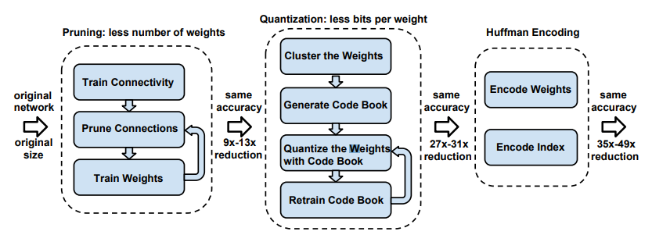
Top Deep Optimization of NNs
Three-stage compression pipeline paper with Pruning + Quantization + Huffman coding
Pruning reduces the number of weights by 10×. Quantization further improves the compression rate between 27× and 31×
Huffman coding gives more compression between 35× and 49x. The compression scheme doesn’t incur any accuracy loss
Notes:
https://arxiv.org/pdf/1510.00149)

Slide 8
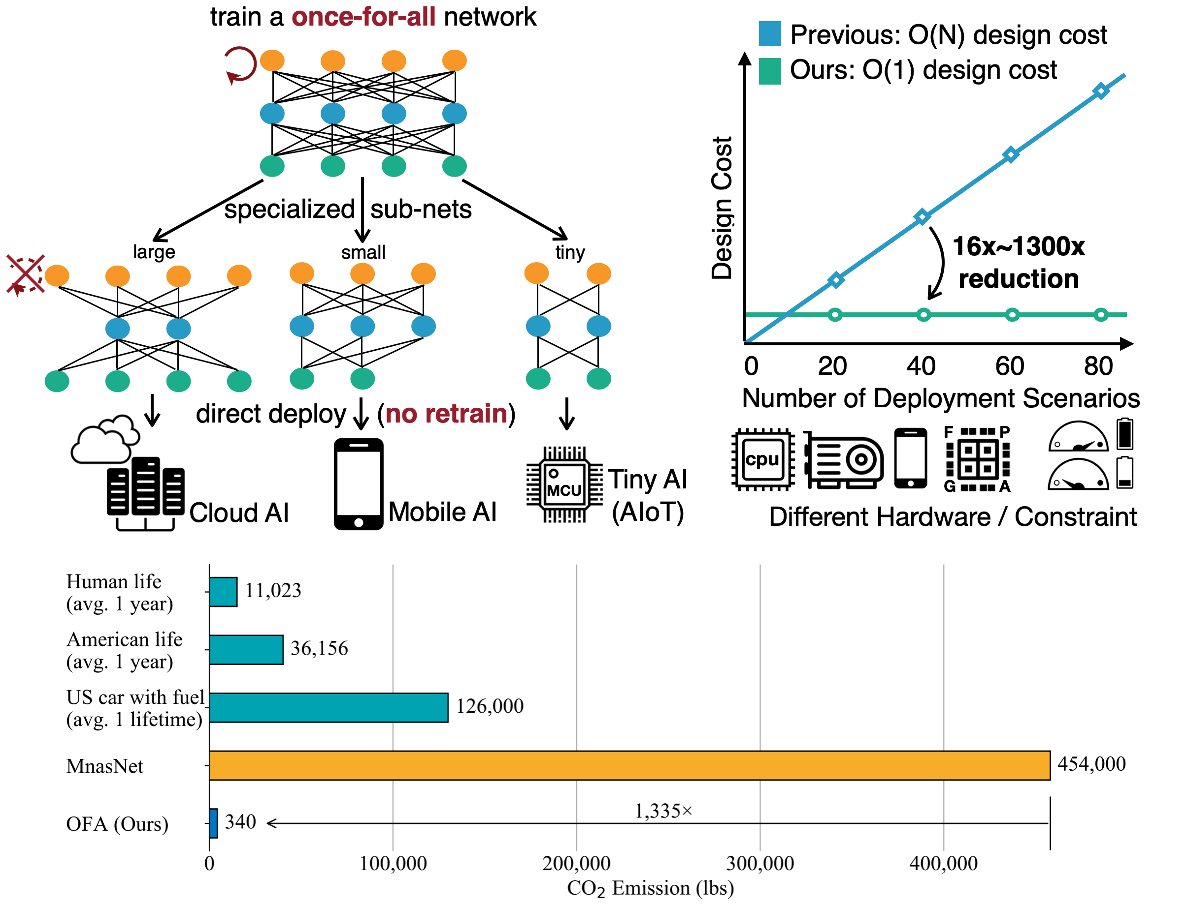
Top Deep Optimization of NNs
Once for all paper
A single network is trained to support versatile architectural configurations including depth, width, kernel size, and resolution
Given a deployment scenario, a specialized subnetwork is directly selected from the once-for-all network without training
This approach reduces the cost of specialized deep learning deployment from O(N) to O(1)
Notes:
https://arxiv.org/pdf/1908.09791.pdf

Slide 9
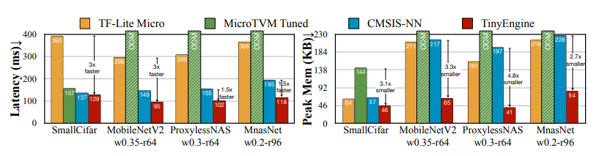
Top Deep Optimization of NNs
MCUNet paper:
TinyEngine achieves higher inference efficiency while reducing the memory usage. 3× and 1.6× faster than TF-Lite Micro (Google) and CMSIS-NN (ARM) respectively
By reducing the memory usage TinyEngine can run various model designs with tiny memory, enlarging the design space for TinyNAS under the limited memory of MCU
Outperforms existing libraries by eliminating runtime overheads, specializing each optimization technique, and adopting in-place depth-wise convolution
Notes:
https://arxiv.org/pdf/2007.10319.pdf

Slide 10
Research Question
Is it possible to combine more than one state-of-the-art optimization technique to achieve deeper compression levels of ML models? If possible, what is the maximum achievable size-reduction, inference speedup, and which combination shows the highest accuracy preservation?

Slide 11
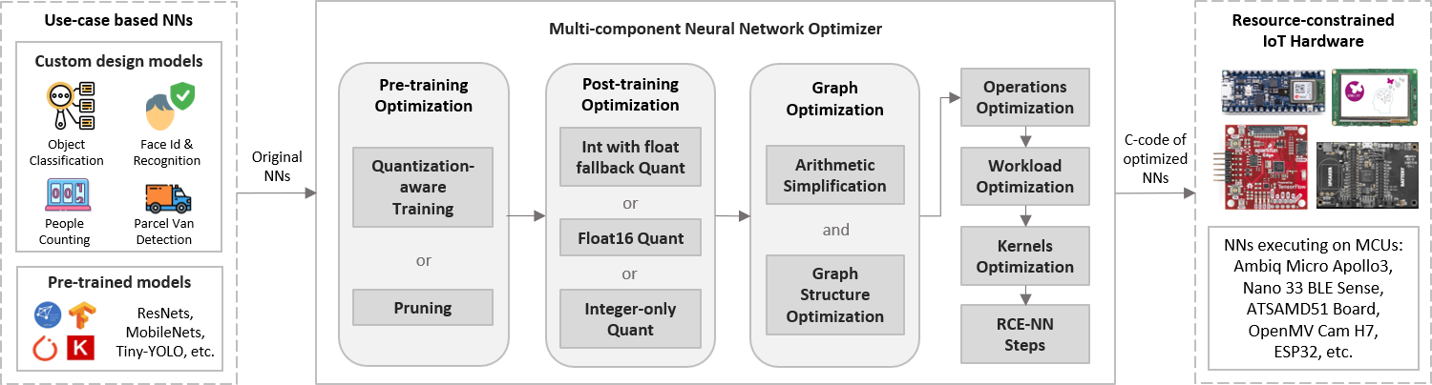
Multi-component NN Optimizer: Architecture
The architecture of our multi-component model optimizer
Sequence to follow for optimizing Neural Networks to enable its execution on resource-constrained AIoT boards, small CPUs, MCUs based IoT devices
In the upcoming slides each optimizer component shall be presented

Slide 12
Use-case based NNs: Input
The optimizer takes a NN as an input and produces a highly optimized version of the input NN that can run on low resource, cost and power MCU-based IoT hardware. The input network can be
Pre-trained models such as Inception, Xception, Mobilenet, Tiny-YOLO, Resnet, etc
Or the custom-designed, yet to be trained networks

Slide 13
Pre-training Optimization
The custom-designed, yet to be trained networks should pass through the pre-training optimization component
Pruning: We implemented the magnitude-based weight pruning, where the model's weights are gradually zeroed out during the training to achieve model sparsity. Thus obtained sparse models are easier to compress, and the zeroes can be skipped during inference, resulting in latency improvements
Quantization-aware Training: When quantizing a CNN, the parameters and computations go from a higher to lower precision, resulting in improved execution efficiency at a cost of information loss. This loss is because the model weights can only take a small set of values, thus losing the minute differences between them. To reduce the loss and maintain the model accuracy, we introduce quantization error as noise during the model training, as part of the overall loss, which the optimization algorithm in use tries to minimize

Slide 14
Post-training Optimization
Quantizes the models by reducing the precision of their weights and activations to save memory and simplify calculations often without much impact on accuracy. Following are the popular techniques we implemented
Int with float fallback quantization: Fully integer quantize a model, but use float operators when they don't have an integer implementation (to ensure conversion occurs smoothly)
Float 16 quantization: Reduce the size of floating point models by quantizing the weights to IEEE standard for 16-bit floating point numbers. Float16 models run on small CPUs without modification
Integer-only quantization: To improve the NN compatibility with integer only hardware devices or accelerators by making sure all model math is in integer

Slide 15
Joint Pre and Post-training Optimization
First, any of the pre-training optimization methods has to be applied to the model, followed by its Int-8 post-training quantization
When more than 11x size reduction is required
Example, when we aim to execute Inception v3 (23.9 MB after quantization) on a AIoT boards, which only has only 16 MB Flash memory
+

Slide 16
Graph Optimization
The interior of trained models is a graph with defined data flow patterns
Graph contains an arrangement of nodes and edges
Nodes represent the operations of a model
Graph edges represent the flow of data between the nodes
We present techniques to optimize graphs of NN to improve the computational performance of NN while reducing peak SRAM usage on MCUs
We perform graph optimization in sequential steps
Arithmetic Simplification
Graph Structure Optimization

Slide 17
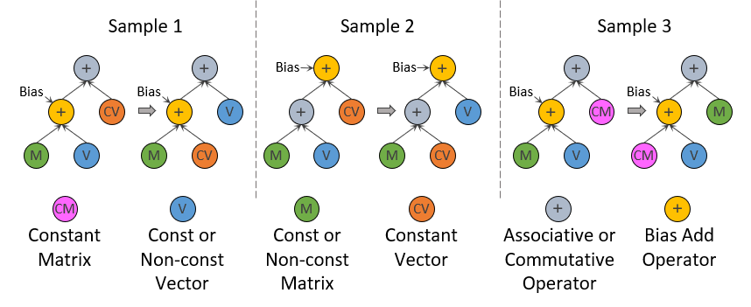
Graph Optimization: Arithmetic simplification
Arithmetic re-writes rely on known inputs. As shown, the known constant vector is grouped with an unknown vector that might be constant or non-constant. After performing such re-writes, if the unknown vector turns out to be a constant, then graph performance improves

Slide 18
Graph Optimization: Graph Structure
We propose tasks that when realized will optimize the graph for efficiency
Task1: Remove loop-invariant sub-graphs. i.e., remove the loops that are true both before and after iterations.
Task2: Remove dead branches/ends from the graphs. So, during execution on MCUs, backtracing from the dead-end is not required to progress in the graph.
Task3: Use a transitive reduction algorithm on entire graph to remove redundant control edges. Shorten the critical path of a model step by rearranging control dependencies
Task4: Replace recurrent subgraphs with optimized kernels/executable modules

Slide 19
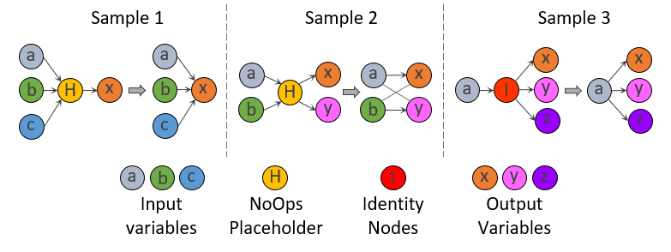
Graph Optimization: Graph Structure
Task5: This task when realized, reduces the graph's size resulting in processing speedups. Here, we identify and remove nodes that are effectively NoOps (a placeholder of control edges) and Identity nodes (outputs data with the same content and shape of input)

Slide 20
Joint Graph and Post-Training Optimization
First, the two Arithmetic simplification and Graph Structure Optimization steps needs to be applied to the original un-optimized model
Then any of the post-training model optimizers need to be applied
+

Slide 21
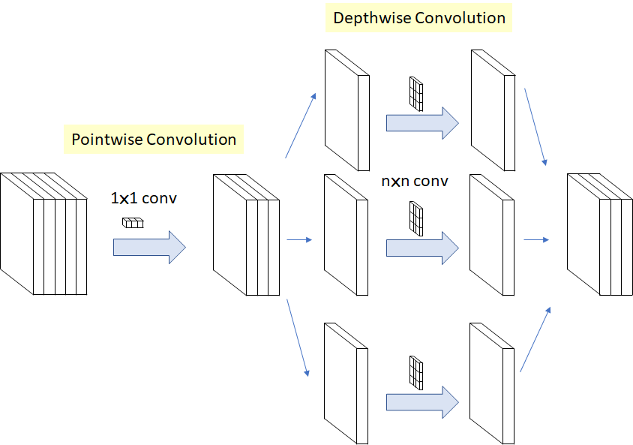
Operations Optimization
When designing ML models for tiny IoT hardware, only limited operations can be used to keep the cost low
Over 90% arithmetic operations are used by convolutional (CONV) layers. So, we already convert floating-point operations into int-8 (fixed point) during post-training quantization
Depth-separation of 3D filters
Also Decompose 2-D CONVs and 1-D CONVs to reduce parameters and operations count
3D convolution uses C * A * B multiplications, whereas a depth-separable 3D convolution only requires C + A + B multiplications

Slide 22
Joint Operations & Post-training Optimization
Even if the models such as MobileNet and SqueezeNet are manually designed to execute within a tight memory budget, it would exceed the AIoT board's capacity by over 5 x times
Hence, we propose to first optimize the operations of any model, then perform post-training model optimization
+

Slide 23
Workload Optimization
The complexity and size of the model have an impact on the workload
Larger and denser models lead to increased processor workload
Hardware spends more time working and less time idle resulting in elevated power consumption and heat output
We present techniques that can be used to reduce workloads. The methods we recommend apply globally, i.e., not biased towards local performance optimizations for a single operation, as in many previous works

Slide 24
Workload Optimization
Input data reduction Use computationally inexpensive low pass filters
Hardware accelerators Resource-constrained devices are not capable to utilize off-the-shelf accelerators. For successful offloads, we recommend
Storing the C code of the optimized model to be executed in a shared memory location
Perform parallel offloading for internal data reuse
Offload the processing to the inbuilt KPU, FFT units
Number of threads Limit the number of threads initialized by NNs for computation
Low-level optimization Perform low-level optimization of convolution to eliminate unnecessary data layout transformation overheads
Linear algebraic properties Analyze the linear algebraic properties of models and apply algorithms such as Strassen Gaussian elimination, Winograd's minimal ﬁltering

Slide 25
Kernels Optimization
The general C/C++ implemented kernels for MCUs need hardware-specific optimizations
We present library independent kernel optimization techniques that are generic across a wide range of resource-constrained hardware for guaranteeing no runtime performance bottlenecks
Remove excess modules, components in project directory before building a project
Group multiple operators together within a single kernel
Go deep into the assembly code level for improving small matrix multiplication tasks. Implement the matrix multiplication kernel with 2x2 kernels to save on load instructions
Convolutions should be partitioned into disjoint pieces to achieve parallelism
Self-customized thread pooling techniques should be used to reduce overheads while launching and suppressing threads to reduce performance jitters while adding threads

Slide 26
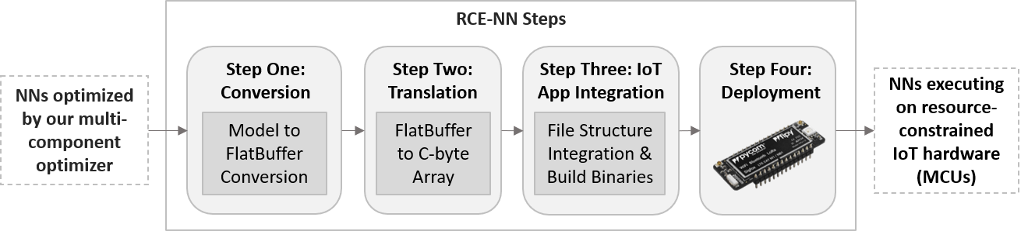
RCE-NN Steps
Step1: Model to FlatBuffer Conversion
Creates flat buffers of the CNNs
Memory-mapped and can be utilized directly from disk/flash
Zero additional memory requirements for data access

Slide 27
RCE-NN Steps
Step2: FlatBuffer to C-byte Array
MCUs in edge devices lack native filesystem support. Hence, we cannot load and execute the regular format (“.h5”, “.pb”, “.tflite”, etc.) trained CNNs
We convert the quantized version of the trained model into a C array and compile it along with the program for the IoT application which is to be executed on the edge device
Translated C byte array:
unsigned char converted_quantised_model [] = {
0x18, 0x00, 0x00, 0x00, 0x54, 0x46, 0x4c, 0x33, 0x00, 0x00, 0x0e, 0x00,
...
...
…
};
unsigned int converted_quantised model_len = 21200;
Command: xxd -i converted_quantised_model file > translated c byte array of model.cc
Method to translate the trained model into a C byte array

Slide 28
RCE-NN Steps
Step3: IoT App Integration
We fuse the trained CNN (translated c-byte array) with the main program of an IoT use-case
We build binaries that will be loaded on MCUs for execution
Step4: Deployment
The generated binaries of a NN model are flashed via serial port on the MCU-based devices
To flash, use an external In-System Programmer (ISP) or a ParallelProgrammer, which does not occupy bootloader space, also avoids the bootloader delay

Slide 29
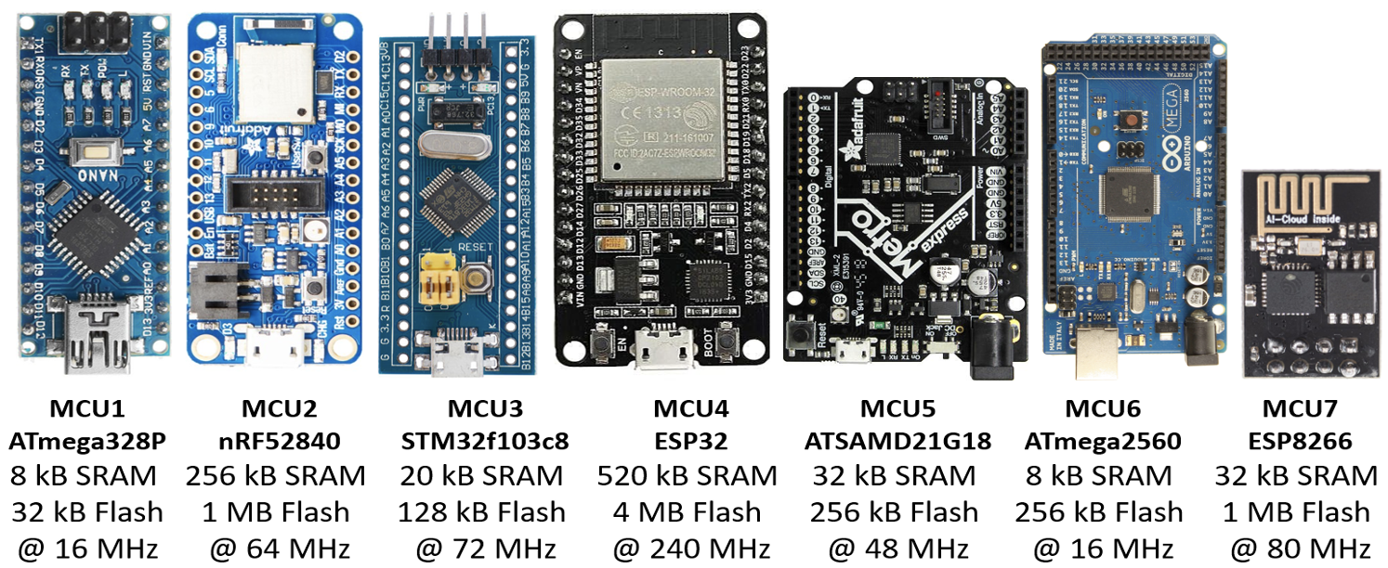
Resource-constrained IoT Hardware: Output
Output: A highly optimized version of the input NN that can run on low resource, cost and power IoT hardware such as the below shown MCUs

Slide 30
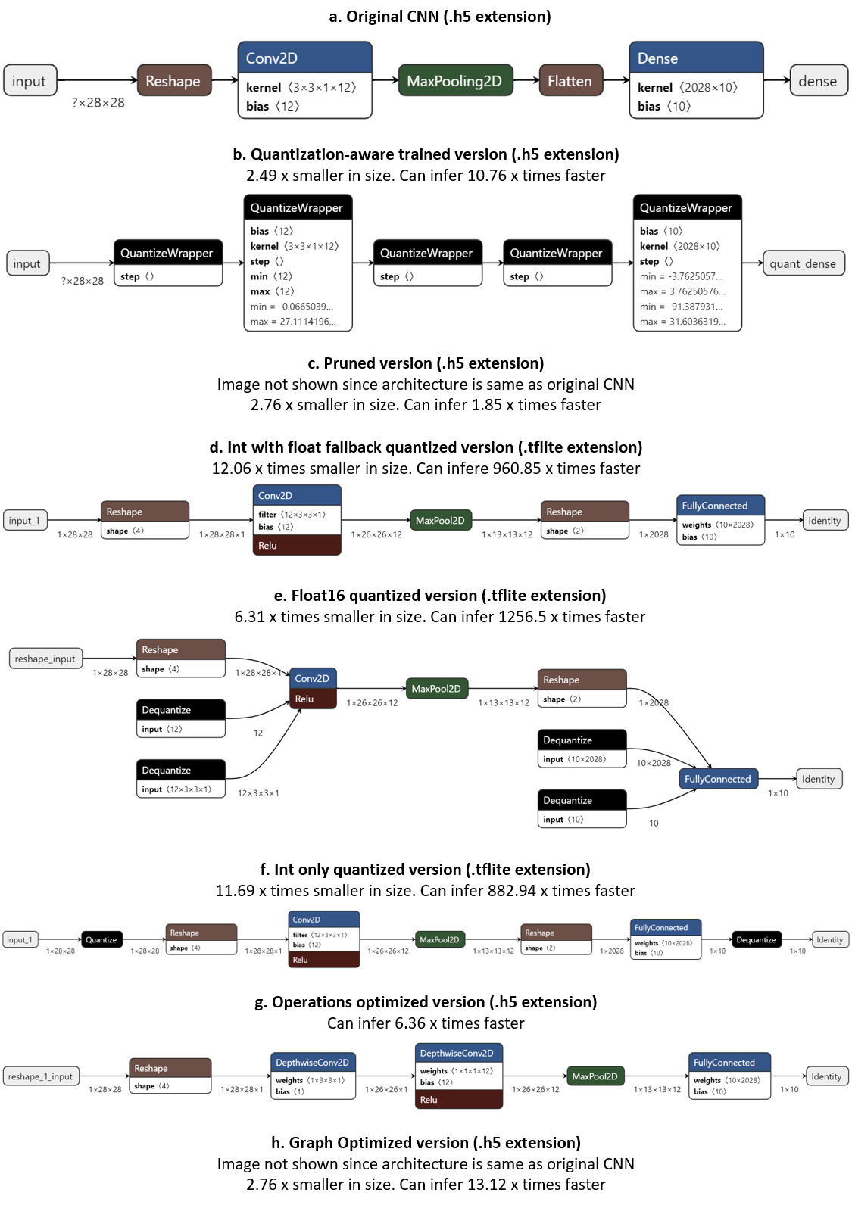
Evaluation Setup
We implement each of the optimizer component on CNNs and present the experimental results
We define a basic CNN whose architecture is shown below
CNN1: When above network is trained using the standard MNIST Fashion dataset
CNN2: When above network is trained using the MNIST Digits datasets

Slide 31
Evaluation: Pre-training Optimization Components
Below, we show the architecture of the QAT CNN1
2.49x smaller in size
Can Infer 10.76 x times faster
The Pruned CNN1 architecture is same as the Original CNN1
2.76x smaller in size
Can Infer 1.85 x times faster

Slide 32
Evaluation: Post-training Optimization Components
Below, we show the architecture of Int with float-fallback quantized CNN1
12.06x smaller in size. Can Infer 960.85 x times faster
Below, we show the architecture of Float16 quantized CNN1
6.31x smaller in size. Can Infer 1256.5 x times faster

Slide 33
Evaluation: Post-training Optimization Components
Below, we show the architecture of Int-only quantized CNN1
11.69x smaller in size. Can Infer 882.94 x times faster
Analyzing the post-training optimization results
Float16 quantization for reasonable compression rates (we obtain approx. 6x compression), without loss of precision (we experience only 0.01 % loss in accuracy)
Int with float-fallback quantization for smallest model size and fastest inference on MCUs
Float16 quantization for fastest inference on CPUs

Slide 34
Evaluation: Operation, Graph Optimization Components
Graph optimized CNN1: We implemented and performed all applicable arithmetic simplification rewrites and graph structure optimization tasks on CNNs
2.76x smaller in size, 13.12x times faster
Below, we show the architecture of the Operations optimized CNN1
6.36x times faster

Slide 35
Optimization Results Analysis
We performed analysis based on the evaluation results
Best Optimization Sequence for Smallest Model Size:
Graph optimized then integer with float fallback quantized version is only 22.5 KB
12.06 x times smaller than original CNN
Best Optimization Sequence for Accuracy Preservation:
Graph optimized then integer only quantized version
For MNIST Fashion, the accuracy increased by 0.27 %, and by 0.13 % for MNIST Digits
Best Optimization Sequence for Fast Inference:
Operations optimized then float16 quantized version
Produces the fastest unit inference results in 0.06 ms

Slide 36
Multi-component Optimizer Summary
To enable ultra-fast and accurate ML-based offline analytics on resource-constrained IoT devices, we present an end-to-end multi-component ML model optimization sequence
Researchers and developers can use our optimization sequence to optimize high memory, computation demanding models in multiple aspects in order to produce small size, low latency, low-power consuming models
Our optimization components can produce models that are; (i) 12.06 x times compressed; (ii) 0.13% to 0.27% more accurate; (iii) orders of magnitude faster unit inference at 0.06 ms

Slide 37
Conclusion
To enable ultra-fast and accurate ML-based offline analytics on resource-constrained IoT devices, we presented an end-to-end multi-component ML model optimization sequence. Researchers and developers can use our optimization sequence to optimize high memory, computation demanding models in multiple aspects to produce small size, low latency, low-power consuming models

Slide 38



Contact: Bharath Sudharsan
Email: bharath.sudharsan@insight-centre.org
www.confirm.ie
Notes:
If you have any further queries you can contact us anytime.
Thank you, stay safe.

